Slide 1
Development of Cyber Physical Layer to defend EV Systems from Cyber Attacks: Simulation based Twining Approach
ESE 534 Cyber Physical Systems Project
Deepi Singh
Reetam Mandal
Yash Patel
Stony Brook University
Oct 2020

Slide 2
Outline
Background
Introduction to Electric Vehicles
Motivation
Circuit Diagram of a typical Motor Drive
Possibilities of Attack
Proposed DT based CP Architecture
References

Slide 3
Background
With advent of cloud control applications in EV systems, cyber threats are posing vulnerability concerns to large-scale EV implementations.
Recent advances in semiconductor device technologies, control architectures, and communication methodologies have enabled researchers to develop integrated smart CPSs that can cater to the emerging requirements of smart grids, renewable energy, electric vehicles, trains, ships, the Internet of Things (IoT), and so on.
However, with the increasing computational capability of the digital signal processors (DSPs) and microcontroller units (MCUs), and the development of the communication network techniques, local controllers can achieve advanced functionalities such as online optimization, fault diagnosis, and multimode operations.
Such functions require the modern EDS (Electric Drive System) to communicate more frequently with the onboard networks than ever, making the EDS much more vulnerable to malicious attacks from the cyber systems.
Notes:
With the growing penetration in the Internet-of-Things (IoT)-enabled applications, Power Electronics Systems including electric vehicles (EVs), are becoming increasingly vulnerable to cyber–physical threats. With increasing connectivity due to vehicle-to-everything (V2X) and the number of electronic control units, network-connected EVs are facing greater cyber–physical security challenges.
Compared to traditional combustion engine vehicles, EVs have a variety of onboard electronic equipment.
Meanwhile,as the power electronics community is still catching up in cybersecurity awareness , it becomes more urgent to develop monitoring and diagnosis strategies for network-connected power electronics systems. existing research extensively focuses on the safety and security of internal combustion engine(ICE) vehicles and fails to address the cyber–physical security of EVs specifically.
For such safety-critical applications, if these threats are not detected at the early stage, they can lead to a catastrophic life-threatening failure and substantial economic loss. In this project, some of the challenges from a cyber-physical security standpoint and potential solutions are discussed for connected EVs from the perspective of powertrain control security.

Slide 4
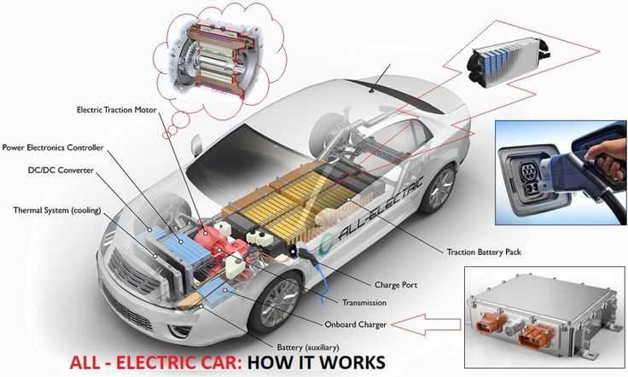
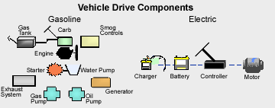
Introduction to Electric Vehicles
EVs composed of the following:
Electric motor
Electric Vehicle Controller(Power electronics controller)
Electric traction motor
Electric transmission
Vs Traditional Fuel-based Vehicles
Internal Combustion Engine(ICE)
Carburetor
Traction Motor
Transmissmission
Notes:
The Electric Vehicle System(EVS) composes of an electric motor, in place of an Internal Combustion Engine(ICE), and the motor transfers power to the wheels via a drive shaft.
The vehicle has a battery that provides electricity to power vehicle components. A charge port allows the vehicle to connect to an external power supply in order to recharge.
The electric vehicle controller(Power electronics controller) is the electronics package that operates between the batteries and the motor, to manage the flow of electrical energy delivered by the traction battery, in order to control the electric traction motor, and in turn, the electric vehicle's speed, acceleration and torque produced much like a carburetor does in a gasoline-powered vehicle.
Using power from the traction battery pack, the Electric traction motor drives the vehicle's wheels. Some vehicles use motor generators that perform both the drive and regeneration functions.
The transmission(electric) transfers mechanical power from the electric traction motor to drive the wheels.
Overall a simpler, cleaner approach than traditional ICE Vehicles.
More details on the electronics of this in further slides.

Slide 5
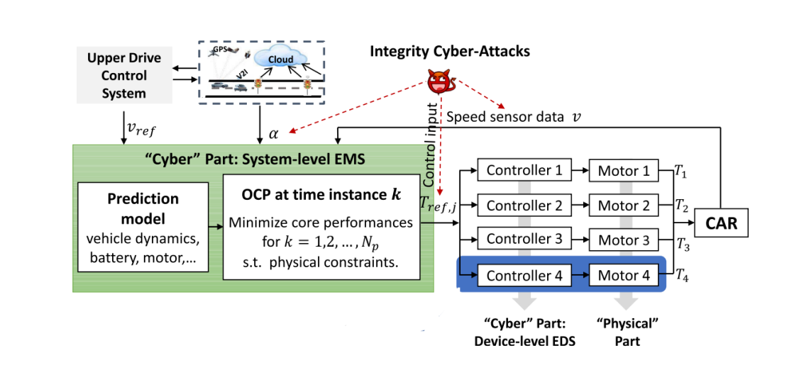
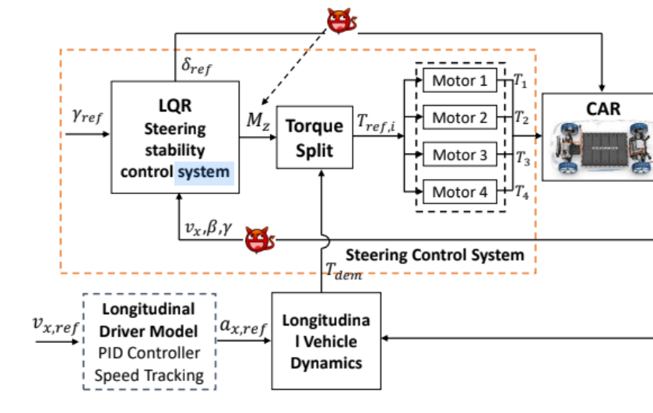
Types of Cyber-Physical Attacks
Sensor Attack - manipulating sensor data that the controller receives.
Controller Attack - manipulating data the controller may receive from the network
Control Signal Attack- manipulating control signal from controller to drive.
Notes:
In this presentation, we will investigate the vulnerabilities of EVs under a variety of cyberattacks targeting the electric drive system of the car, that in turn can affect the lateral stability and cause life threatening consequences.
Later on, an architecture for the next-generation power electronics systems is proposed to address the cyber–physical security challenges of EVs.

Slide 6
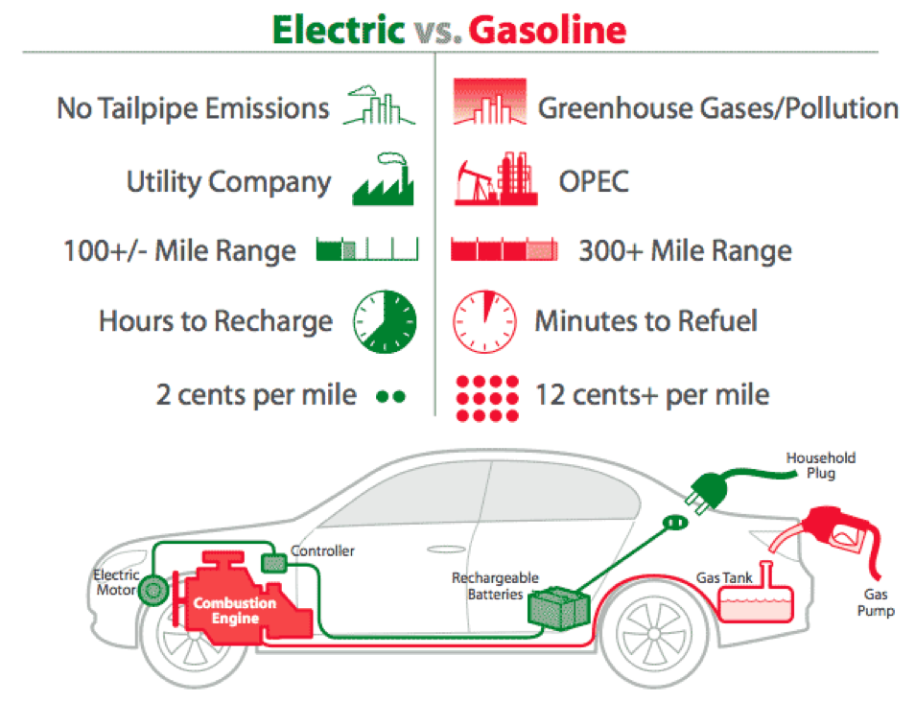
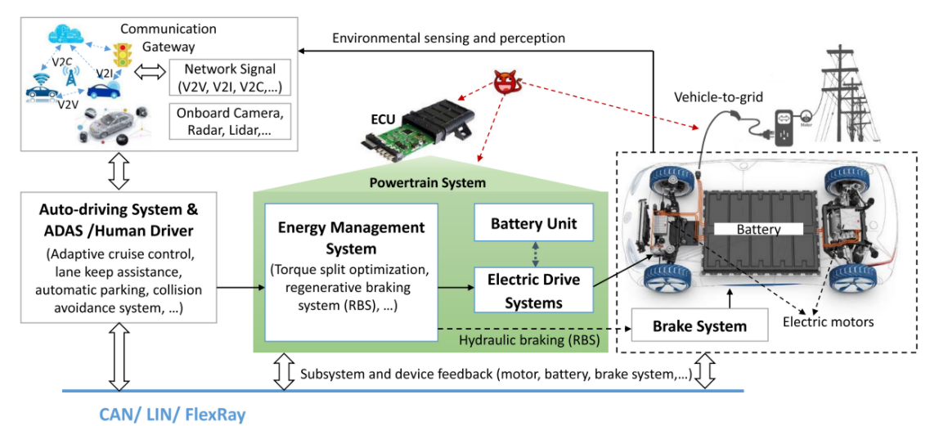
Motivation
Electric vehicles(EVs) are gaining popularity as a solution to the drastic climate change issues
In contrast to traditional ICE vehicles, EVs bring along new challenges in the CPS security design.
The stability of the car depends on torque deviation between the distributed motors. So cyber-threats to motor drives will cause vehicle instability and life-threatening consequences.
If attackers can arbitrarily modify sensor measurements, and hijack the powertrain system, it will significantly hamper large-scale adoption of EVs.
Thus the need for a coordinated detection methodology to evaluate and evade cyber-physical attacks on the motor drives.
Notes:
Electric vehicles(EVs) are rapidly gaining popularity as a viable solution to the drastic climate change and transportation issues in growing metropolitan cities.
In contrast to traditional combustion engine vehicles, EVs bring along new challenges in the Cyber-Physical Systems (CPS) security design. As the lateral stability of the car is designed through the yaw moment generated by the torque deviation between distributed motors, cyber-threats to motor drives will cause vehicle instability and hence life-threatening consequences. If attackers can illegally access the in-vehicle communication buses, arbitrarily modify the sensor measurements, and hijack the powertrain system, it will significantly hamper large-scale adoption of EVs.
Thus the need for a coordinated detection methodology to evaluate and evade cyber-physical attacks on the motor drives.

Slide 7
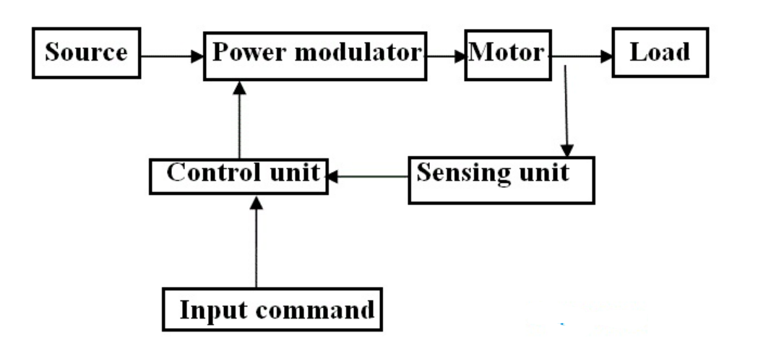
Block Diagram of Electric Drive
A drive operates and controls the speed, torque and direction of moving objects. Drives are generally employed for speed or motion control applications such as machine tools, transportation, robots, fans, etc. The drives used for controlling electric motors are known as electrical drives.

Slide 8
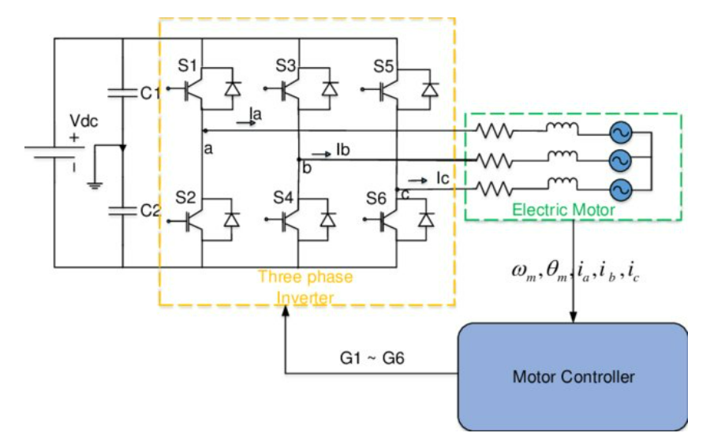
Circuit Diagram of an Electric Drive System

Slide 9
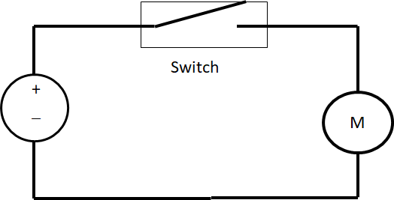
Continued…..
D1, D2, --------- D4
Controller
I/P Commands
Sensors
Indicator

Slide 10
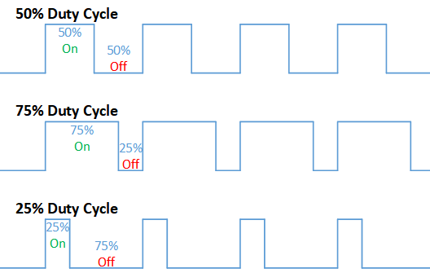
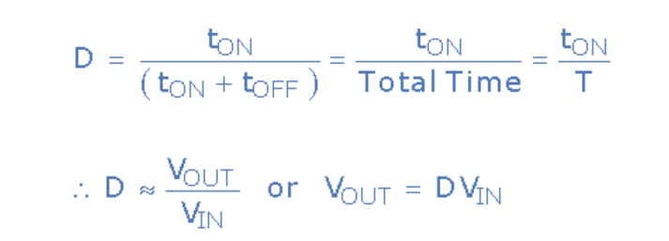
Duty Cycle of Power Electronics Switch

Slide 11
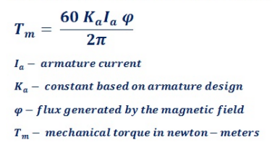
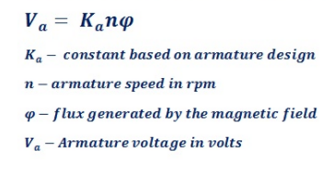
Speed and Torque Equations of Motor
Equation of Speed
Equation of Torque
Voltage and Current equation of motor
Va = Eb + IaRa
Eb = Back E.M.F IaRa = Armature Current X Armature Resistance

Slide 12
Conventional Approach
Our CPS Modification
Operating References V_{ref}, T_{ref}, N_{ref}
Cloud
V_{out} Sensor I_{out} Sensor
HIL SIMULATION of EV
D1,2,3,4 Control Signal (Corrected)
Cyber Layer
Digital Twin RK + Optimization
Bound Check
Controller
D1,2,3,4 Control Signal
V predicted, I predicted
Cyber Attack Classification
Notes:
The conventional EV system takes ideal conditions where there is no infringement at play. Most of the vehicles are now coupled with sensors for component failure/system of components failure as an add-on feature. The controller (conventional system) actuates the system with the data that is fed from cloud/serial bus for further implementation of the logic and the system would proceed normally. This mode does not take into account malfunctioning due to a breach or attack which really poses a threat on a large scale given the growth in this sector.
The model we propose uses the idea of having a digital twin which would emulate the entire system and be able to simulate every process as if it were in an ideal case scenario. Digital twinning is relatively a new field when it comes to real time analysis which is lacking in simulations. Given the amount of data and refinement, digital twinning can help in reduction of tampering, errors and many more issues in better light as compared to standard simulations.
Here as you can see we’ve got a cloud server where our data is hosted and using various protocols it is interpreted by the Hardware in Loop simulation of an EV. That data is interpreted and depending on the user demand there is a Vout and Iout values fed into the controller; essentially being the first window for an attack. The controller identifies with the server the reference values which is where there is another window for an attack. Lastly the controller would have a set duty cycle for operation of the motor which would be based on the incorrect values fed into the controller as a consequence of the infringement. Our implementation of the Digital twin Cyber physical system coupled with Runge Kutta optimization and bound check which would ascertain the real time ideal prediction of the system and classify the zone that has been compromised by the cyber attack. Depending on the need the cost analysis would correct the duty cycle of the motor hence rendering the attack void.

Slide 13
We first use Digital Twin to emulate the behavior of controller on basis on an input signal.
We take the input signal, extract the signature and pass it through a predictor system; this predictor block should be able to predict the effect of the signal.
We train the predictor block with bounds to classify it safe or a violation.
If safe, the signal is passed on to the actual physical controller.

Slide 14
References
J. Zhang, L. Guo and J. Ye, "Hardware-in-the-Loop Testbed for Cyber-Physical Security of Photovoltaic Farms," 2021 IEEE 12th International Symposium on Power Electronics for Distributed Generation Systems (PEDG), 2021, pp. 1-7, doi: 10.1109/PEDG51384.2021.9494258.
S. K. Mazumder et al., "A Review of Current Research Trends in Power-Electronic Innovations in Cyber–Physical Systems," in IEEE Journal of Emerging and Selected Topics in Power Electronics, vol. 9, no. 5, pp. 5146-5163, Oct. 2021, doi: 10.1109/JESTPE.2021.3051876.
J. Ye et al., "Cyber–Physical Security of Powertrain Systems in Modern Electric Vehicles: Vulnerabilities, Challenges, and Future Visions," in IEEE Journal of Emerging and Selected Topics in Power Electronics, vol. 9, no. 4, pp. 4639-4657, Aug. 2021, doi: 10.1109/JESTPE.2020.3045667.

Slide 15
Continued...
M. Amin, F. F. M. El-Sousy, G. A. A. Aziz, K. Gaber and O. A. Mohammed, "CPS Attacks Mitigation Approaches on Power Electronic Systems With Security Challenges for Smart Grid Applications: A Review," in IEEE Access, vol. 9, pp. 38571-38601, 2021, doi: 10.1109/ACCESS.2021.3063229.
Lulu Guo; Bowen Yang; Jin Ye; Hong Chen; Fangyu Li; WenZhan Song; Liang Du; Le Guan
Systematic Assessment of Cyber-physical Security of Energy Management System for Connected and Automated Electric Vehicles Transactions on Industrial Informatics, 2020

Slide 16
Thank You

Slide 17
